Slide 1
Build a recommendation engine (part 3)
Data Science Workshop

Slide 2
You show your solution

Slide 3
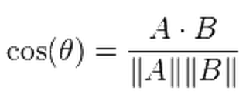
You show your solution
  The efficiency issue:
    The efficiency of calculating cosine similarity of all user pairs:

Slide 4
I show my solution

Slide 5
What is the difficulty you encountered

Slide 6
Let’s us matrix
  How to calculate everything once with matrix:
    Show the procedure in white board;
    Show the code;
    Run it a little bit;

Slide 7
Advanced Techniques

Slide 8
Ways to build a recommendation engine
  Multiple approaches:
    Search based approach
    Cluster models
    Collaborative Filtering:
      User oriented CF
      Product oriented CF
      Matrix factorisation

Slide 9
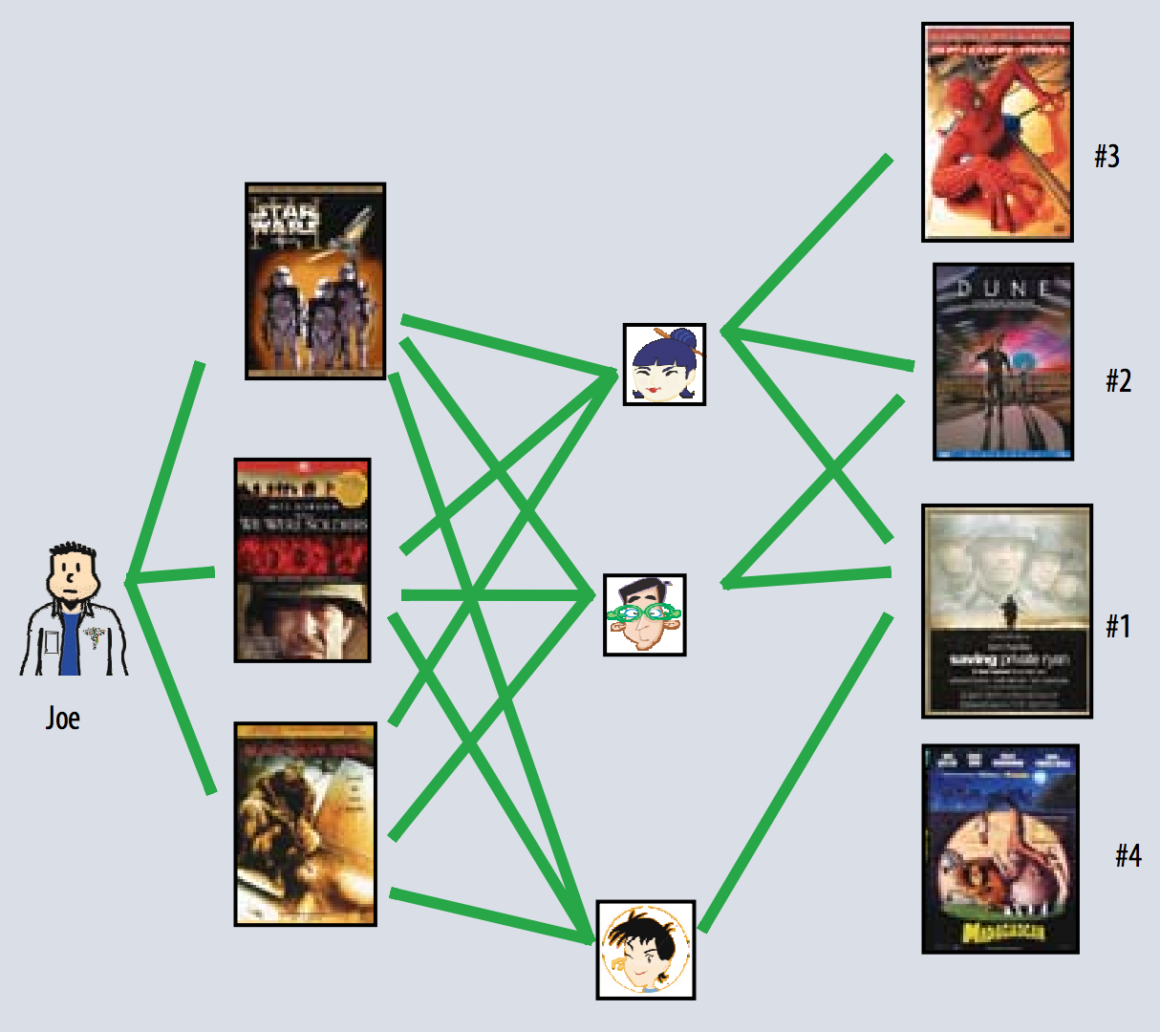
Remember this?
  “I like what you like”:

Slide 10
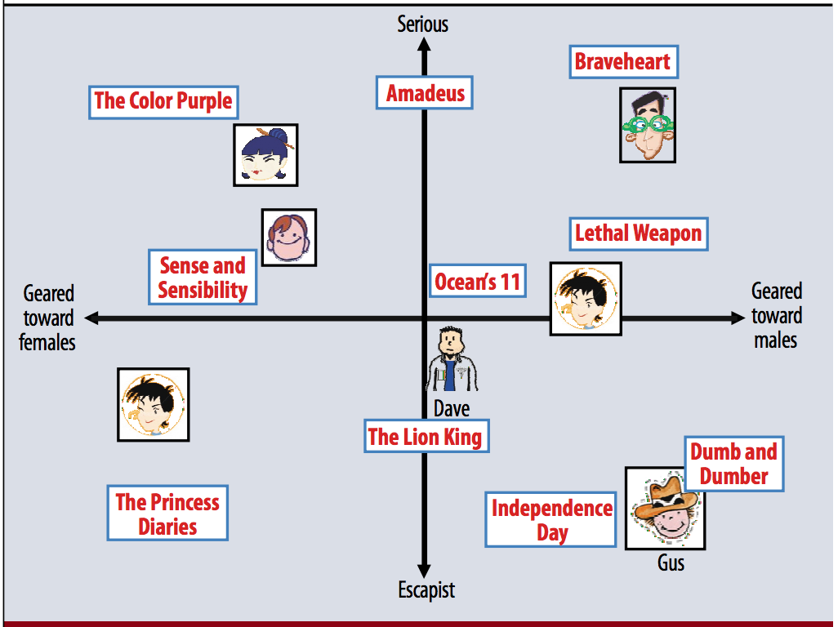
So what about matrix factorisation
  Using the matrix to infer hidden features.

Slide 11
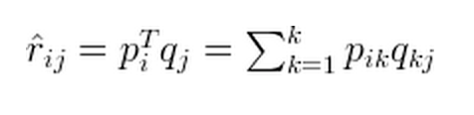
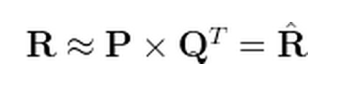
Matrix Factorisation
  So what we want is:
    User/Movie represented by some features in common
    You can call it reverse engineer:

Slide 12
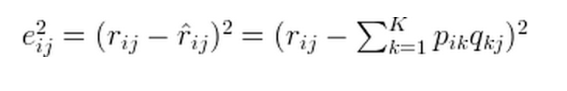
Matrix Factorisation
  We want the error to be minimised:

Slide 13
Matrix Factorisation
  We want the error to be minimised:

Slide 14
Matrix Factorisation
  How to do that?

Slide 15
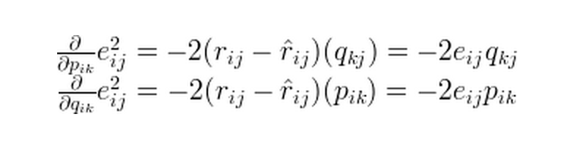
Matrix Factorisation
  How to do that?

Slide 16
Some solutions on code

Slide 17
Thank you

